Slide 1
5-Axis Positioning

Slide 2
Benefits
Clamp once, cut multiple setups
  Save time
  Avoid human error
  Accuracy (repeatable tolerances to get to each setup)

Slide 3
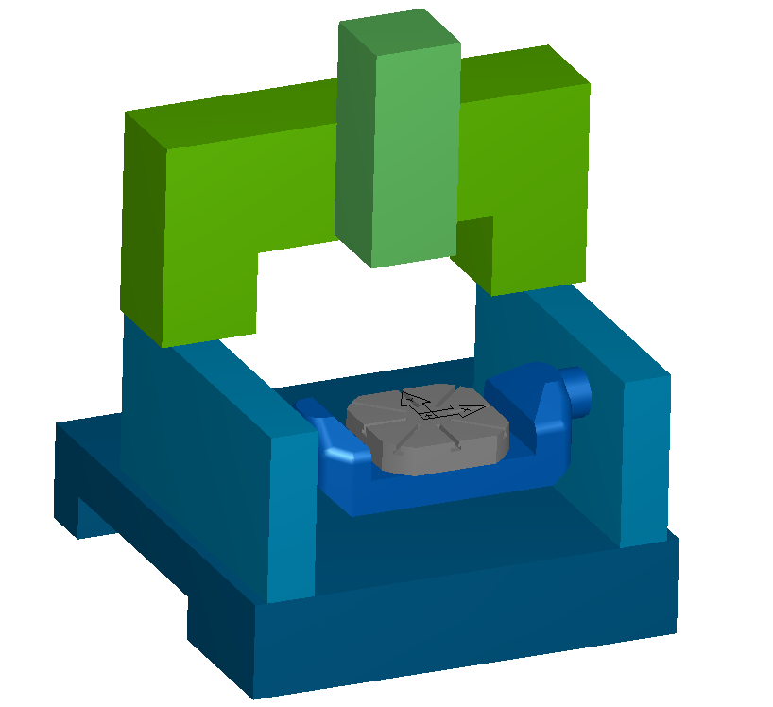
Machine Types
Table/table
  Horizontal
  Vertical (shown)
Notes:
Both tables rotates
Horizontal: the tool stays horizontal; the part rotates
Vertical: the tool stays vertical; the part rotates

Slide 4
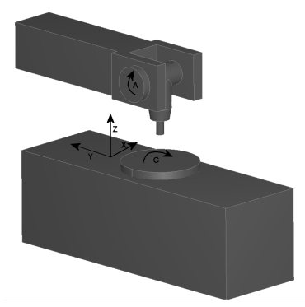
Machine Types
Table/head
  C table/B head
  C table/A head (shown)
Notes:
The table rotates and the head rotates
The tool can be at any angle on the YZ plane in the picture

Slide 5
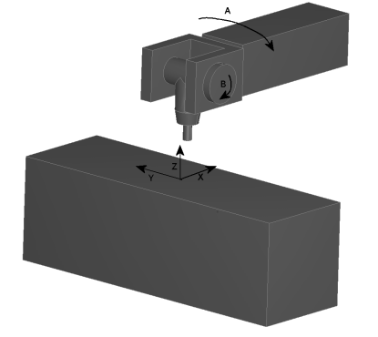
Machine Types
Head/head
  C head/A head
  B head/A head
  A head/B head (shown)
Notes:
Both rotations are in the head
The tool can be pointing anywhere

Slide 6
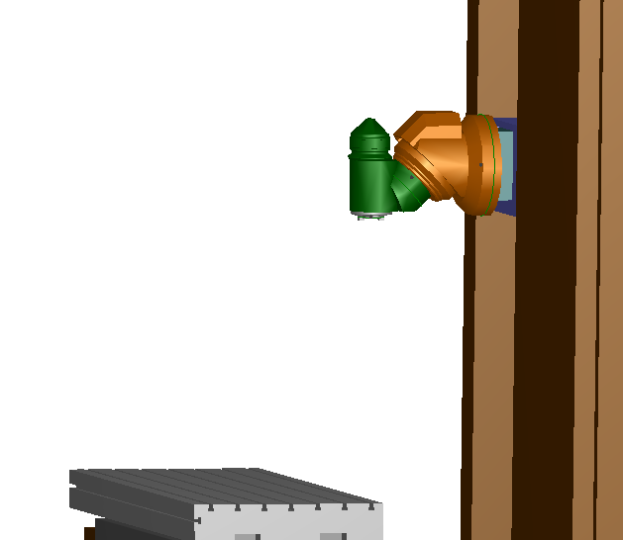
Machine Types
Head/Angled Head
  B head/45° A head (shown)
  A head/45° B head
Notes:
The A-axis is actually not aligned with the X-axis but at a 45 degree; we still call it the A-axis

Slide 7
Requirements
For table/head and head/head machines, they have to support:
  Automatic correction of tool length offset
  3D coordinate transformation
Notes:
Table/table machines do not have the requirements because the tool is always pointing the same direction

Slide 8
Why the Requirements?
Automatic correction of tool length offset
  XYZ in the NC code is the XYZ of the tooltip
tooltip
NC
NC = tooltip
Notes:
Present on modern 5-axis machines
As the tool rotates, the machine moves the tool in XYZ to maintain the tooltip at the same point
Left picture: if automatic correction is not done, the tooltip and the point the NC code is controlling don’t match
Right picture: if automatic correction is done, the tooltip and the point the NC code is controlling match

Slide 9
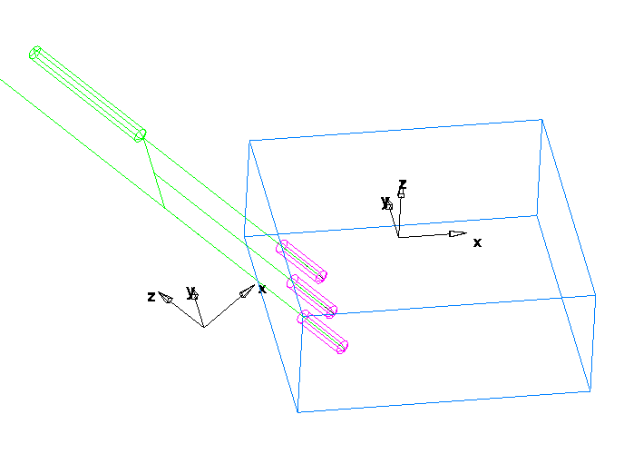
Why the Requirements?
3D coordinate transformation
  Z moves stay as moves in Z (necessary for hole canned cycles and cutter comp)
Original CS
New CS
Notes:
Present on modern 5-axis machines
An option on lower end machines
After setting up the new coordinate system, all movements are then based on that CS

Slide 10
3D Coordinate Transformation
Fanuc machines use G68
For a C head A head machine, you’d use
G68 I0 J0 K1 R45
G68 I1 J0 K0 R10
The first G68 rotates the CS about the Z-axis (I0J0K1) by 45 degrees (C angle)
The second G68 rotates the CS about the X-axis (I1J0K0) by 10 degrees (A angle)
Notes:
Two consecutive transformations are allowed and you need exactly two to get to any CS. Think of it as one for each rotary axis.

Slide 11
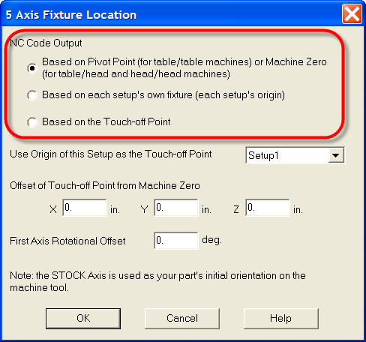
NC Code Output
Based on the Pivot Point (for table/table machines) or Machine Zero (for table/head and head/head machines)
  Entire NC code is based on one fixed and non-rotating point
Or, you can use fixtures (G54, G55, etc.) to establish a reference point for each setup
  Each setup has its own reference point
Or, you can generate NC code that is based on the Touch-off Point
  Again one fixed and non-rotating point
Notes:
Emphasize ONE!!!
The picture shows the radio buttons to select between them

Slide 12
Table/Table Machine
To use fixtures, you would need to set the XYZ of the G54, G55, etc. before machining
  Clamp the part
  Rotate to each setup
  Find the XYZ of the origin
  Set it as G54, G55, etc.

Slide 13
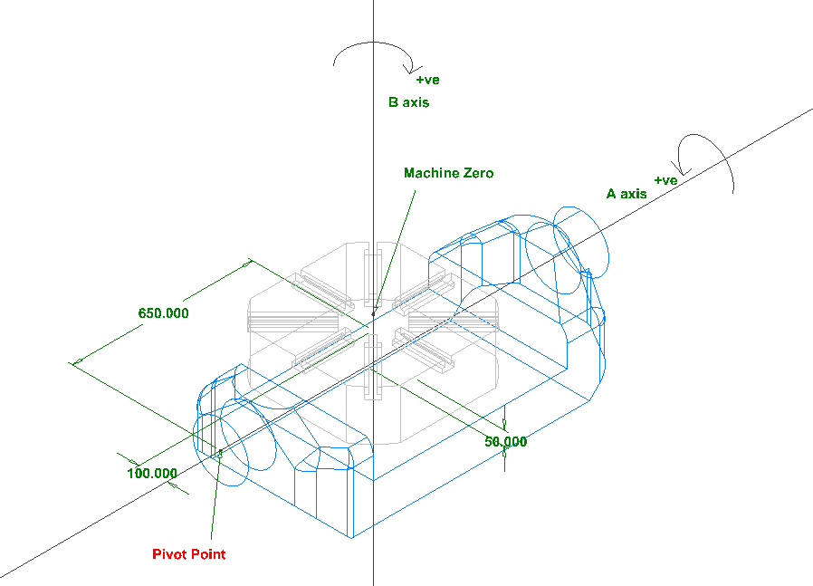
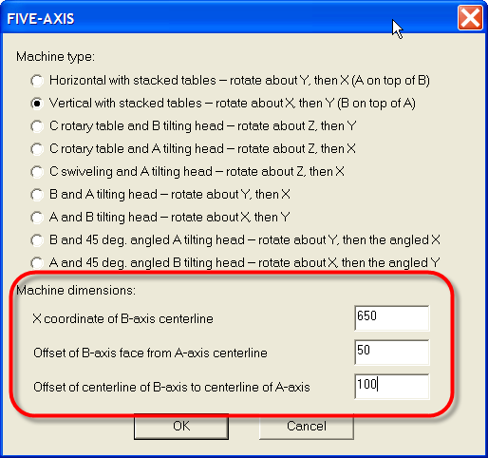
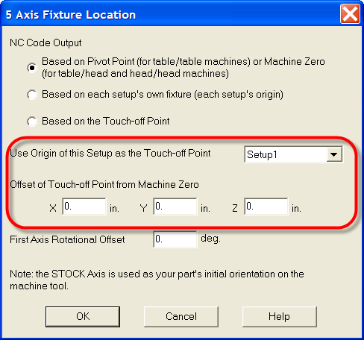
Table/Table Machine
To use Pivot Point or Touch-off Point, FeatureCAM needs the dimensions of the rotary axes and the touch-off offset
Notes:
The left picture shows the Pivot Point. Positive rotations on the A-axis and B-axis are opposite of the right hand rule because the part actually moves and not the tool
The lower right picture shows the touch-off offset
The upper right picture shows the dimensions of the rotary axes
Originally each toolpath is based on its setup. We first use touch-off offset to translate the toolpaths so that they are based on Machine Zero. After that we can rotate them about the B axis. We then use the dimensions of the rotary axes to translate the toolpaths so that they are now based on the Pivot Point. Finally, we can rotate them about the A axis
If using Touch-off Point, we need to translate the toolpaths one last time back from Pivot Point to the Touch-off Point
The Pivot Point can actually be anywhere on the A-axis. For example, if it is more convenient to have the Pivot Point underneath the face of the B-axis table, you could specify zero for “X coordinate of B-axis centerline”

Slide 14
Table/Table Machine Demo
Fixtures
  vertical fixture.fm
Pivot Point
  vertical pivot.fm
Touch-off Point
  vertical touch-off.fm
CNC
  Fan16m5x Example-Vertical.CNC
Notes:
Fixtures
Open “vertical fixture.fm” and set CNC to “Fan16m5x Example-Vertical.CNC”
Make sure “Use 0 to -180…” on the secret menu (Ctrl+Right Click the Status Bar) is off
Center All and then Isometric view
Bring up the 5 Axis Fixture Location dialog and show that we are using fixtures
Toolpath and then NC
Setup1 is align with the initial orientation
Point to N40A0B0 (no rotation)
Zoom in to groove1
The fixture is G54: point to N45G54 and the G54 annotation on the part
Select ln11 and point to N50X1Y2 and N65X2Y3 (which are the same as the end points of ln11 – no transformation)
Center All, Isometric view and then switch to Setup2
To rotate to Setup2
Point to N95A90B-90 (A90 and B-90)
Press Alt+1 to show A90 and then Alt+L multiple times to rotate back and forth. Make sure A90 is shown last
For B-90, the B-table would have to rotate -90 degrees
Open “vertical fixture2.fm”, Center All, Isometric view, and then Ctrl+Tab multiple times to switch between the two files. Make sure the new file is shown last
UCS2 is the actual orientation of the machine which does not match the orientation of Setup2 (UCS_Setup2)
Toolpath, NC, and then zoom in to groove2
The fixture is G55: point to N100G55 and the G55 annotation on the part
Select ln12 and point to N110X1Y-.5 and N125X2.5Y-1 (which are the same as the end points of ln12 under UCS2 – transformed from UCS_Setup2)
Pivot Point
Close all files, open “vertical pivot.fm”
Center All and then Isometric view
Bring up the 5 Axis Fixture Location dialog and show that we are using Pivot Point
In this case, the touch-off offset to Machine Zero (pt37) is the width and thickness of the stock
Select pt37. The XYZ are relative to UCS1 which is at the Pivot Point. So the XYZ equals to the dimensions of the rotary axes
Open the CNC file, bring up the Five-Axis dialog to show that it has the same numbers
Toolpath and then NC
Setup1 is align with the initial orientation
Point to N40A0B0 (no rotation)
There is no fixture G code (no G54)
Zoom in to groove1
Select ln11 and point to N45X26Y2 and N60X27Y3 (which are the same as the end points of ln11 under UCS1 – transformed from UCS_Setup1)
Center All, Isometric view and then switch to Setup2
To rotate to Setup2
Point to N90A90B-90 (A90 and B-90)
Press Alt+1 to show A90 and then Alt+L multiple times to rotate back and forth. Make sure A90 is shown last
For B-90, the B-table would have to rotate -90 degrees
Open “vertical pivot2.fm”, Center All, Isometric view, and then Ctrl+Tab multiple times to switch between the two files. Make sure the new file is shown last
UCS2 is the actual orientation of the machine which does not match the orientation of Setup2 (UCS_Setup2)
Toolpath, NC, and then zoom in to groove2
There is no fixture G code (no G55)
Select ln12 and point to N100X26Y3.5 and N115X27.5Y3 (which are the same as the end points of ln12 under UCS2 – transformed from UCS_Setup2)
Touch-off Point
Close all files, open “vertical touch-off.fm”
Center All and then Isometric view
Bring up the 5 Axis Fixture Location dialog and show that we are using Touch-off Point
In this case, the touch-off offset to Machine Zero (pt37) is the width and thickness of the stock
Select pt37. The XYZ are relative to UCS1 which is at the Pivot Point. So the XYZ equals to the dimensions of the rotary axes
Open the CNC file, bring up the Five-Axis dialog to show that it has the same numbers
Toolpath and then NC
Setup1 is align with the initial orientation
Point to N40A0B0 (no rotation)
There is no fixture G code (no G54)
Zoom in to groove1
Select ln11 and point to N45X1Y2 and N60X2Y3 (which are the same as the end points of ln11 – no transformation)
Center All, Isometric view and then switch to Setup2
To rotate to Setup2
Point to N90A90B-90 (A90 and B-90)
Press Alt+1 to show A90 and then Alt+L multiple times to rotate back and forth. Make sure A90 is shown last
For B-90, the B-table would have to rotate -90 degrees
Open “vertical touch-off2.fm”, Center All, Isometric view, and then Ctrl+Tab multiple times to switch between the two files. Make sure the new file is shown last
UCS2 is the actual orientation of the machine which does not match the orientation of Setup2 (UCS_Setup2)
UCS2 is also at where the Touch-off Point is. To show this:
Press Alt+1 to center around UCS2
Switch back to the old file, switch to UCS_Setup1 (the Touch-off Point), press Alt+2 to center around it
Ctrl+Tab multiple times to switch between the two files. Make sure the new file is shown last
The part and tables rotates but the UCSs are stationary
Toolpath, NC, and then zoom in to groove2
There are no fixture G code (no G55)
Select ln12 and point to N100X1Y3.5 and N115X2.5Y3 (which are the same as the end points of ln12 under UCS2 – transformed from UCS_Setup2)

Slide 15
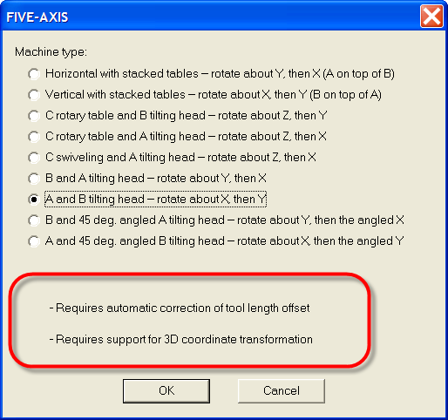
Table/Head or Head/Head Machine
To use fixtures, you would need to set the XYZ of the G54, G55, etc. before machining
  Clamp the part
  Rotate to each setup
  Find the XYZ of the origin
  Set it as G54, G55, etc.
Need the two requirements

Slide 16
Table/Head or Head/Head Machine
To use Machine Zero or Touch-off Point:
  No need for rotary axis dimensions
  Still need touch-off offset
Need the two requirements
Notes:
For table/head machines, the Machine Zero is at the center of the C-axis table
For head/head machines, the Machine Zero can be anywhere. If you can set it to be the same as the Touch-off Point then the touch-off offset is 0,0,0. In that case, both the Machine Zero and the Touch-off Point options will give you the same result

Slide 17
Head/Head Machine Demo
Fixtures
  C A head fixture.fm
Machine Zero
  C A head machine zero.fm
Touch-off Point
  C A head touch-off.fm
CNC
  Fan16m5x Example-C A Head.CNC
Notes:
Fixtures
Close all files, open “C A head fixture.fm” and set CNC to “Fan16m5x Example-C A Head.CNC”
Bring up the 5 Axis Fixture Location dialog and show that we are using fixtures
Select hole1_4 and then rotate around to show that it is angled
Toolpath and then NC
To rotate to Setup5
Point to N335A54.736C135 (A54.736 and C135)
Start with UCS5 which is aligned with the initial machine orientation. The origin is the same as Setup5’s because we are using fixtures
Rotate UCS5 about Z by 135 and then about X by 54.736
Select pt4 and point to N355X0Y0 and N370Z-1.075 (which are the same as the XYZ of pt4 under UCS5)
Machine Zero
Open “C A head machine zero.fm”
Bring up the 5 Axis Fixture Location dialog and show that we are using Machine Zero
Touch-off offset is set to -2.5,-2.5,0 which is the center of the stock’s top face
Select hole1_4 and then rotate around to show that it is angled
Toolpath and then NC
To rotate to Setup5
Point to N335A54.736C135 (A54.736 and C135)
Start with UCS5 which is aligned with the initial machine orientation. The origin is at Machine Zero
Rotate UCS5 about Z by 135 and then about X by 54.736
Select pt4 and point to N355X0Y-2.041 and N370Z1.812 (which are the same as the XYZ of pt4 under UCS5)
Touch-off Point
Open “C A head touch-off.fm”
Bring up the 5 Axis Fixture Location dialog and show that we are using Touch-off Point
Select hole1_4 and then rotate around to show that it is angled
Toolpath and then NC
To rotate to Setup5
Point to N335A54.736C135 (A54.736 and C135)
Start with UCS5 which is aligned with the initial machine orientation. The origin is at Touch-off Point
Rotate UCS5 about Z by 135 and then about X by 54.736
Select pt4 and point to N355X0Y-4.082 and N370Z4.698 (which are the same as the XYZ of pt4 under UCS5)

